Slide 1
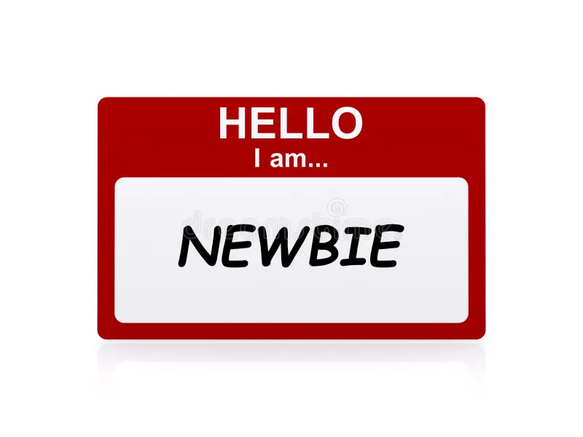

KnewB
Founded September 12th, 2024
CMU Created for Pittsburgh Students, Sponsored by Heinz College Students
Notes:
Slide 1: Introduction (Ariana)
"Welcome to KnewB, where we provide a thriving guide to Pittsburgh life. Whether you're navigating your first year in the city or seeking out the best places to explore, KnewB is your go-to tool to help you not just survive, but thrive.” [NEXT SLIDE]

Slide 2
AGENDA
Team
Problem
Vision
Solution & Demo
Market
Business Model
Competition
Next Steps
Notes:
Slide 2: Agenda Walkthrough (Ariana)
"Today, we’ll take you through the key areas of KnewB:
Our team
The problem that we’re solving.
Our vision
Our solution with a quick demo to show KnewB in action. [TRANSITION]
And finally, we’ll explore the market, business model, competition, and next steps."
"Let’s meet the KnewB team—a group of graduates from Carnegie Mellon who remember what it's like to be a KnewB in this city. [NEXT SLIDE]

Slide 3
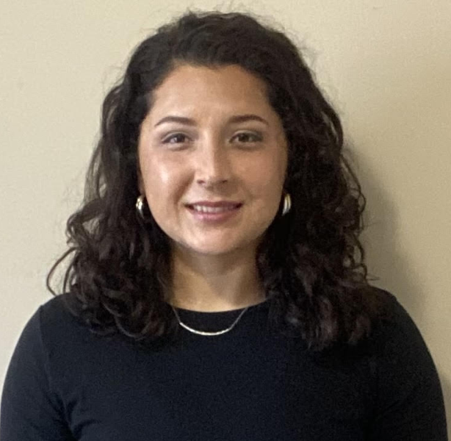



TEAM
Ariana Rocha
CEO
CMU Graduate
Wenting Yue
CFO
CMU Graduate
afrocha@andrew.cmu.edu
wyue2@andrew.cmu.edu
Xiaoyang Ma
COO
CMU Graduate
Saicharan Emmadi
CTO
CMU Graduate
xm3@andrew.cmu.edu
semmadi@andrew.cmu.edu
Notes:
Slide 3: Team Introductions (Ariana)
"Let’s meet the KnewB team—a group of graduates from Carnegie Mellon who remember what it's like to be a KnewB in this city. [NEXT SLIDE]
[TRANSITION] Ariana Rocha, our CEO, has a strong background in leadership and strategy, ensuring KnewB’s growth and vision stay on course.
[TRANSITION] Wenting Yue, our CFO, focuses on keeping costs low—both for us and for you—so you can explore the city without worrying about your budget.
[TRANSITION] Xiaoyang Ma, our COO, manages operations, ensuring you get the most relevant and timely recommendations to make the best out of your Pittsburgh experience.
[TRANSITION] And finally, Saicharan Emmadi, our CTO, builds the tech behind KnewB, ensuring you get a smooth, personalized experience every time.
Together, we’re here to help you navigate Pittsburgh Life" [NEXT SLIDE]

Slide 4





PROBLEM
Being New in Town Can Wear you Down
Notes:
Slide 4: Problem (WenTing)
"Being new in town can wear you down:
[TRANSITION] One Wrong Food Move and You’ve blown your budget… or your bowels.
[TRANSITION] Choose the wrong scene, and you’re stuck turning a night you wanted to remember to a night you’ll soon forget.
[TRANSITION] Take the wrong turn, and suddenly you’re in a place you’d rather not be or around the wrong people
[TRANSITION] These are real concerns for new students, and current solutions—like scattered city guides or online reviews—just aren’t enough. We’re here to make sure KnewBs are informed and safe as they navigate their new space."
[NEXT SLIDE]
OLD SLIDE CONTENT
What is the customer pain point? Newcomers to Pittsburgh often struggle to find reliable and comprehensive information on local dining, entertainment, and safety.
What is the current solution for this pain? Current solutions include generic online reviews and scattered city guides, which can be overwhelming and inconsistent.
How much does it cost? The cost varies depending on the source, but can range from free, low-cost apps, to premium services with subscription fees.
Why is it broken? These solutions are often fragmented, lack personalization, and fail to provide a cohesive, trustworthy overview of the city's offerings.

Slide 5






VISION
KnewB’s Thriving Guide to Pittsburgh Life
Notes:
Slide 5: Vision (WenTing)
[TRANSITION] "Our vision is simple: Providing KnewBs a thriving guide to Pittsburgh life. We’re here to make sure everything goes right:
[TRANSITION] Feast Without the Fear: Not only will you save money, but your tastebuds will be singing by the end of your night.
[TRANSITION]Go to Events That Excite: Find the best things to do, and always have a great time. Whatever your interest, there’s a place for you in Pittsburgh and we’re going to guide you every step of the way.
[TRANSITION] Stay safe and secure by remaining informed about local crime statistics and by avoiding dangerous locations.
Here at KnewB, we want to help you thrive in this beautiful city with the hope that you too can call it home someday."
[NEXT SLIDE]
OLD SLIDE CONTENT
Our vision is to be the ultimate guide for newcomers to Pittsburgh, ensuring they feel welcomed and informed. We strive to enhance their experience by offering curated recommendations for local dining, entertainment, and safety, making their transition smooth and enjoyable. Through personalized service and a deep understanding of the city's unique offerings, we aim to turn every newcomer into a proud Pittsburgher.

Slide 6
SOLUTION & PRODUCT DEMO
Notes:
Slide 6: Solution (WenTing)
"KnewB is an all-in-one city guide that provides curated recommendations based on your personal preferences. Whether it’s the best restaurants, entertainment spots, or safety tips, KnewB is your go-to resource for a seamless transition to Pittsburgh life."
[TRANSITION TO CODE DEMO]
Slide X: Demo (Saicharan)
Here, we cut to a video demonstration of KnewB in action, showcasing the personalized recommendations and real-time safety features.
[NEXT SLIDE]
OLD SLIDE CONTENT
KnewB product
Our product functions as a personalized recommendation system or city guide. We provide recommendations in key areas such as dining, entertainment, and safety, all designed to make the user’s transition to Pittsburgh smoother and more enjoyable. For example, users can browse curated restaurant suggestions based on their preferences, find the best local attractions for entertainment, and access safety tips and neighborhood insights.
KnewB value proposition
We offer newcomers to Pittsburgh a personalized and seamless experience by providing recommendations for dining, entertainment, and safety. Unlike generic city guides or fragmented online reviews, our platform delivers trustworthy, insights tailored to individual preferences.
Impact on the customer
This product can save customers time by providing streamlined platform that consolidates all essential information—dining, entertainment, and safety—newcomers can quickly access the resources they need without sifting through overwhelming or irrelevant content.

Slide 7









MARKET - PCHE
Notes:
Slide 7: Market (XiaoYang)
"KnewB’s market is growing fast. Pittsburgh has one of the highest densities of higher education institutions per capita in the U.S., and we’re focusing on the influx of students who need personalized guidance.
We’re starting with a pilot program at Carnegie Mellon University, afterall, as graduates from the institution we have insight into the customer base. Starting small at CMU gives us the chance to optimize the user experience before expanding in phases to other schools and the broader city.
[TRANSITION] Our collaboration with the Pittsburgh Council on Higher Education (or PCHE for short) ensures that students across these [TRANSITION] institutions will benefit from KnewB. This includes Carlow University, Pittsburgh Theological Seminary, Robert Morris University, the University of Pittsburgh, Chatham University, Duquesne University, La Roche University, and Point Park University. All of which have already been accounted for in our data analysis and long term planning efforts. "
[NEXT SLIDE]
OLD SLIDE CONTENT
KnewB market / target customer
People who are new to Pittsburgh or are here for the first time, specifically: students, employees, and tourist. New Students in Universities moving to Pittsburgh, PA roughly 10-20,000 annually
How big is the market?
Approximately 20,000 incoming students, including undergraduates, graduates, and exchange students from local universities. Around 10,000 visitors annually, as well as new residents or employees relocating to the city.
What are the market forces / drivers?
There is a steady influx of students from local universities along with new employees relocating for jobs in Pittsburgh’s growing tech and healthcare sectors. Moreover, there is also a rising number of tourists seeking authentic city experiences. Finally, there is an increasing demand for personalized, easily accessible information that go beyond traditional, fragmented city guides.

Slide 8
BUSINESS MODEL
Retail
Partnership
Event
Booking
Advertisement Revenue
Notes:
Slide 8: Business Model (XiaoYang)
[TRANSITION] "KnewB generates revenue through [TRANSITION] partnerships with local businesses, [TRANSITION] event bookings, and [TRANSITION] advertisements. For example, a local restaurant can promote their services on our platform, or a user can book an event directly through KnewB. We keep our transaction and advertisement fees low—just $0.50 per placement—to maintain accessibility for students and businesses alike."
[NEXT SLIDE]
OLD SLIDE CONTENT
How does KnewB make money?
Retail Partnerships: Collaborate with retail stores to facilitate online order processing and earn commissions on sales.
Event Bookings: Partner with local sightseeing destinations to handle event bookings and charge a service fee.
Advertisement Revenue: Display advertisements for stores, events, and local attractions to generate ad revenue.
Pricing details
Convenience Fee: Charge a convenience fee of $0.50 per transaction.
Advertisement Fee: Earn an advertisement fee of $0.50 per placement.
Include metrics, e.g.:
Number of Site Visits per Day: Track daily user traffic to gauge platform engagement.
Average Order Value (AOV): Measure the average value of transactions made on the platform.
Customer Lifetime Value (LTV): Calculate the estimated revenue from each customer over their engagement period with the platform.

Slide 9



COMPETITION
Notes:
Slide 9: Competition (XiaoYang)
"Sure, there are platforms like Yelp [TRANSITION] Citizen, [TRANSITION] or Visit Pittsburgh, [TRANSITION] but KnewB offers more. You may be asking, [NEXT SLIDE]
OLD SLIDE CONTENT
Who are the key players?
VisitPittsburgh (restaurants, events, festivals…)
Yelp, GoogleMap (Great for restaurant reviews, but lacks safety and event integration)
Citizen : Provides crime data but no integration with dining or entertainment

Slide 10

WHY KnewB?
STUDENT
CONNECTIONS
ALL-IN-ONE
FOOD
SAFETY
FUN
Notes:
Slide 10: Competition (XiaoYang)
“Why KnewB?” Unlike other companies we hit [TRANSITION] the target every time. Our unique [TRANSITION] connection to the students of our pilot program [TRANSITION] at Carnegie Mellon provides us the perfect launching point from which to grow our success. [TRANSITION] We take a wholistic approach to the newcomer problem by combining dining, safety, and entertainment into one seamless experience tailored to students. Beyond that we provide real-time safety alerts, unlike our competitors, and our deep local expertise sets us apart. With KnewB, you’ll stay safe, eat well, and have fun."
[NEXT SLIDE]
OLD SLIDE CONTENT
How is KnewB differentiated?
All-in-One Platform: Combines food, events, and safety data, offering a comprehensive local experience.
Targeted to CMU Students & Faculty: We understand student needs better, focusing on budget-friendly options and campus safety.
Real-Time Safety Alerts: Provides live safety updates alongside food and event suggestions.
Local Expertise: Strong connections with the extensive Pittsburgh university community give us a unique edge and insight into the student population wants and needs.

Slide 11

WHAT’S NEXT?
Student Engagement Events
Local Companies Collaborations
University and Government Partnerships
GOAL:
(1yr) 1,000 users per academic year
(3yr) 10,000 users per academic year
(5yr) 20,000 users per academic year
Notes:
Slide 11: What’s Next (Ariana)
"At KnewB, we’re just getting started, and our next steps are all about strategic growth:
[TRANSITION] We’ll be hosting tailored events for new students at CMU and the University of Pittsburgh to drive early adoption and build awareness. These engagements will be our key to onboarding users right from the start of their Pittsburgh journey.
[TRANSITION] We’re collaborating with local businesses to offer exclusive deals and opportunities to our users, creating mutual value while driving platform activity.
[TRANSITION] University and Government Partnerships: Finally, we are forging partnerships with the PCHE universities and local government agencies where the objective is that they allow us to integrate KnewB into larger student and resident onboarding programs, expanding our reach and establishing us as a trusted resource for Pittsburgh newbies.
[TRANSITION]Our goal is to onboard 1,000 new users in the first year, scale to 10,000 users by year three, and hit 20,000 users by year five. With this user growth, we’re projecting $100,000 in revenue by year three, and $300,000 by year five, with additional streams from premium features and expanded partnerships.
With your investment, you can expect a potential profit margin of 20-30% by year three, growing to 35-40% by year five as our platform scales and our monetization strategies mature. We invite you to be part of this exciting journey, as KnewB becomes the essential tool for Pittsburgh’s newest residents."
[NEXT SLIDE]
OLD SLIDE CONTENT
What is the KnewB customer acquisition approach?
Student Engagement Events: Host tailored events for new students at CMU and University of Pittsburgh to raise awareness and drive early adoption, specifically during orientation.
Collaborative Initiatives with Local Companies: Partner with local companies to co-host events that showcase the benefits of our solution to their customer base.
University and Government Partnerships: Conduct informative sessions with university and government officials to build trust and explore institutional collaborations.
What are key drivers and potential milestones?
Registered Users: Target number of users signed up: 10,000 / academic year
Transactions: Total number of successful transactions: 10,000 / academic year

Slide 12

Ariana Rocha
CEO
CMU Graduate
afrocha@andrew.cmu.edu
Wenting Yue
CFO
CMU Graduate
wyue2@andrew.cmu.edu
Xiaoyang Ma
COO
CMU Graduate
xm3@andrew.cmu.edu
Saicharan Emmadi
CTO
CMU Graduate
semmadi@andrew.cmu.edu
Notes:
Slide 11: Closing Remarks (Ariana)
"Thank you for taking the time to walk through KnewB with us today. We’re not just building an app; we’re creating a platform that solves real problems for newcomers to Pittsburgh—problems that have been largely overlooked. Our vision, Providing KnewBs a thriving guide to Pittsburgh life, isn’t just about making life easier; it’s about unlocking the potential of every new resident and student by helping them integrate smoothly, find the best this city has to offer, and stay safe along the way.
As Pittsburgh continues to grow as a tech and education hub, KnewB will be there, providing value not only to its users but to local businesses and institutions eager to connect with these newcomers.
This is your opportunity to be a part of that growth. With you as an investor in the KnewB team we can take our vision from a city-wide solution to a profitable model that can be expanded to other cities facing the same challenges.
Invest in KnewB today—because every newcomer deserves to thrive, not just survive."
OLD SLIDE CONTENT
KnewB market / target customer
People who are new to Pittsburgh or are here for the first time, specifically: students, employees, and tourist. New Students in Universities moving to Pittsburgh, PA roughly 10-20,000 annually
How big is the market?
Approximately 20,000 incoming students, including undergraduates, graduates, and exchange students from local universities. Around 10,000 visitors annually, as well as new residents or employees relocating to the city.
What are the market forces / drivers?
There is a steady influx of students from local universities along with new employees relocating for jobs in Pittsburgh’s growing tech and healthcare sectors. Moreover, there is also a rising number of tourists seeking authentic city experiences. Finally, there is an increasing demand for personalized, easily accessible information that go beyond traditional, fragmented city guides.

